Slide 1
Citizenship Issues Faced by the Children of Marriage Migrants in Taiwan
Hsiao-Chuan Hsia
Professor , Graduate Institute for Social Transformation Studies,
Shih Hsin University, Taiwan

Slide 2
Introduction
Background of marriage migration:
Since mid-1980s; Mostly working class;
Population and source countries;
Conditions: economic constraints, isolation, discrimination, legal constraints
Marriage migration challenges citizenship
based on blood→multicultural citizenship

Slide 3
Children of marriage migrants from the Southeast Asia and Mainland China, experience unequal citizenship as the results of their mothers’ partial citizenship
Focused on children of SEA marriage migrants .

Slide 4
Stories of “run-aways”
1. Fang, a caregiver in 2003 but ran away from abusive employer→ undocumented → met aiwanese husband and had a son→to regularize her status, she surrender herself to the authorities, assuming to be granted legal standing→ deported and banned from reentering Taiwan for five years

Slide 5
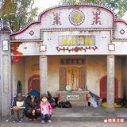
2. Family of 3 living in graveyard for almost 1.5 years.
Run-away migrant cohabitated with a divorced Taiwanese man in 2005→not legally registered marriage because of undocumented status
→had a daughter, not registered until 8 years old
→for daughter to attend school, she surrendered
→blood test showed daughter
not the man’s biological daughter
→both deported

Slide 6
3. marriage migrant had been in Taiwan for 22 years→divorced 6 years ago without Taiwanese citizenship or permanent residency→continued to stay in Taiwan as the custody of her son→ faced deportation after her son turn 20 (legal age) if not fulfilling financial requirements (>160 thousand US$) as “general foreigner”

Slide 7
Separation from Parents due to insecure status of marriage migrants
If one parent is citizen, automatically citizen, but may be separated from parents if:
MM divorced without citizenship, and without custody of minor children
Migrant-parent violated laws, including “run-away” from abusive employer

Slide 8
Under Scrutiny of State and Society

Slide 9
Discourse of “New Taiwan’s Children”
Term created by Media in 2004 and immediately become popular
Only referred to children of marriage migrants from SEA and Mainland China
“delayed development”—capacity of speaking Chinese (v.s. children born to Caucasians parents)

Slide 10
Fear of “deteriorating quality of population” (人口素質)—Marriage Migrants
From neglect to gaze on the marriage migrants—statistics released in 2002
Programs aiming at improving the “quality” of the children born to Southeast Asian and Mainland Chinese mothers

Slide 11
Why?
National Anxiety intensified by globalization (after 1997): tracing media reports
Threat to “Taiwan’s Economic Miracle”

Slide 12
Essentialist understanding of the economic success—good population quality
—ignoring the geo-politics (cold war, U.S. aids)

Slide 13
“Vanguards” of New South-bound Policy
Sudden shift of gaze
Solution of the shrinking economy, esp. under the threat of PRC growth
Expected to inherit SEA languages and cultures→vanguards of Taiwanese nationalist economy
Highlighted few “successful” stories

Slide 14
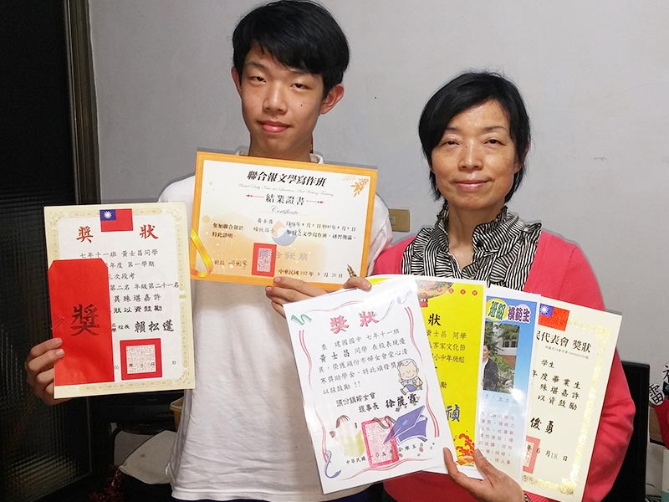
Ignoring unequal citizenship faced by MM
Children of MM also experience partial citizenship, if not only formal citizenship, but also substantial citizenship
Full citizens should enjoy wide choices of careers and paths of lives,
liberty of being
ordinary, “unsuccessful” in
Fields determined by
state and society

Slide 15
Stereotypes and discrimination against them are closely related to those against their mothers (MM)
Reflecting the hierarchy of race under capitalist globalization (not all MM are discriminated)

Slide 16
Empowerment of Marriage Migrants by TASAT

Slide 17
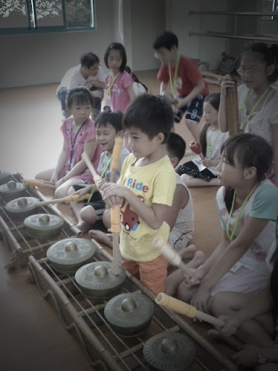
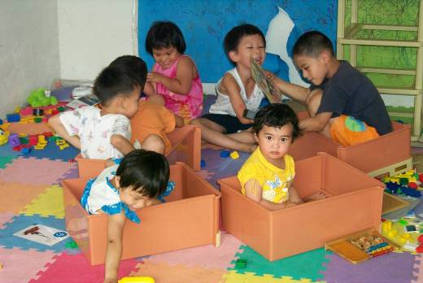
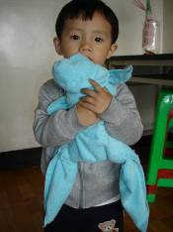
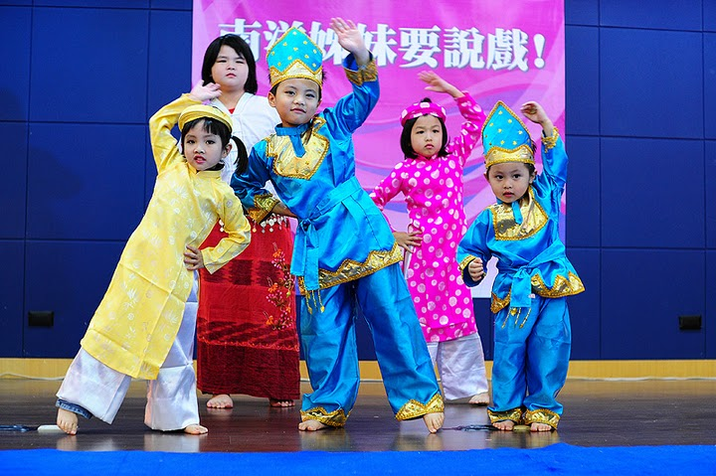
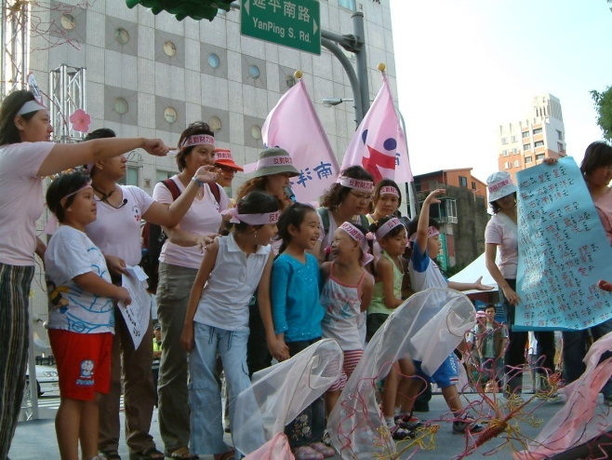
TASAT’S Program of Empowering Mothers and Children

